Slide 1
Genetic Algorythm
Adam Steciuk

Slide 2
Sumary of the problem
Premise of the exercise was to implement genetic algortihm using JGAP library in order to optimize performance of SuperTracker robot
Optimization should by done by tweaking 4 values of the robot:
The distance limit to consider that the enemy is close
The probability of changing speed
Range of possible robot speeds
Minimum robot speed

Slide 3


Solution draft of main program
Setup genes - each for one of the values to be tweaked:
Setup and set sample chromosome:

Slide 4
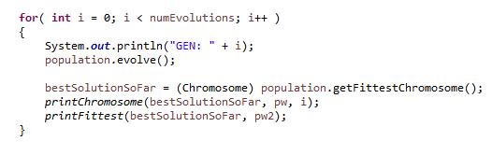
Create initial population:
Evolve pupulation in a loop while printing the fittest chromosome of each generation to two seperated log files:

Slide 5
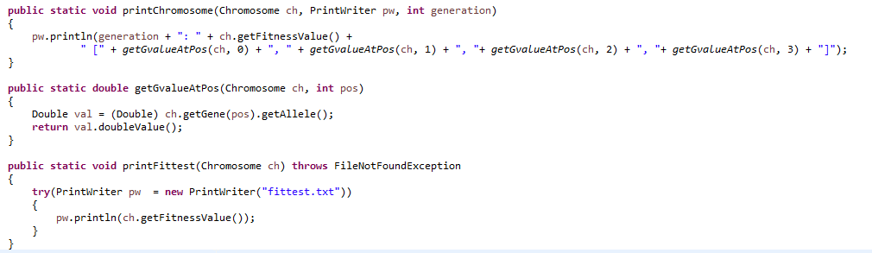
Function used to print log files:

Slide 6
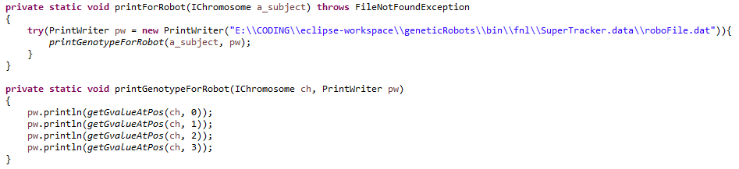
Solution draft of used fitness fuction
Constructor sets fitness to lovest posibble value of 1
Values of genes are printed to a file so a robot could read tchem upon its construction:
Unfortunatelly I couldn’t force the robocode to work as I wnated and hat to print the values to a robot specific folder in .dat file (I described this issue in Virtual Campus).

Slide 7

Solution draft of used fitness fuction
Add battle listener and start battle between SuperRamFire and SuperTracked is started

Slide 8

Use event BattleCompletedEvent in order to set fitness value accordin to batlle results:
Because score returned by getScore() method is a proper evaluation of how succesfull the robot was and always returns non-negative value the only thing we have to do is to add 1 to it. That assures that the fitness value is always an int greater or equal to 1 and mesures how good our robot is (higher = better) just as we need fitness value to be.

Slide 9
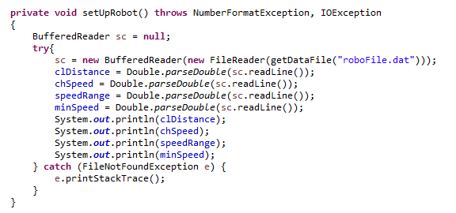
Solution draft of SuperTracer
The only change I made here was to create funtion setUpRobot() that reads and updates robot variables:
The fuction is called in the main run() function. The way of implementing robot communication was inspired by sample.SittingDuck robot which uses file reading and writing. Beside that I also changed all ocurrences of Math.random to Random.nextDouble() with fixed seed as advised in premiss of the exercise

Slide 10
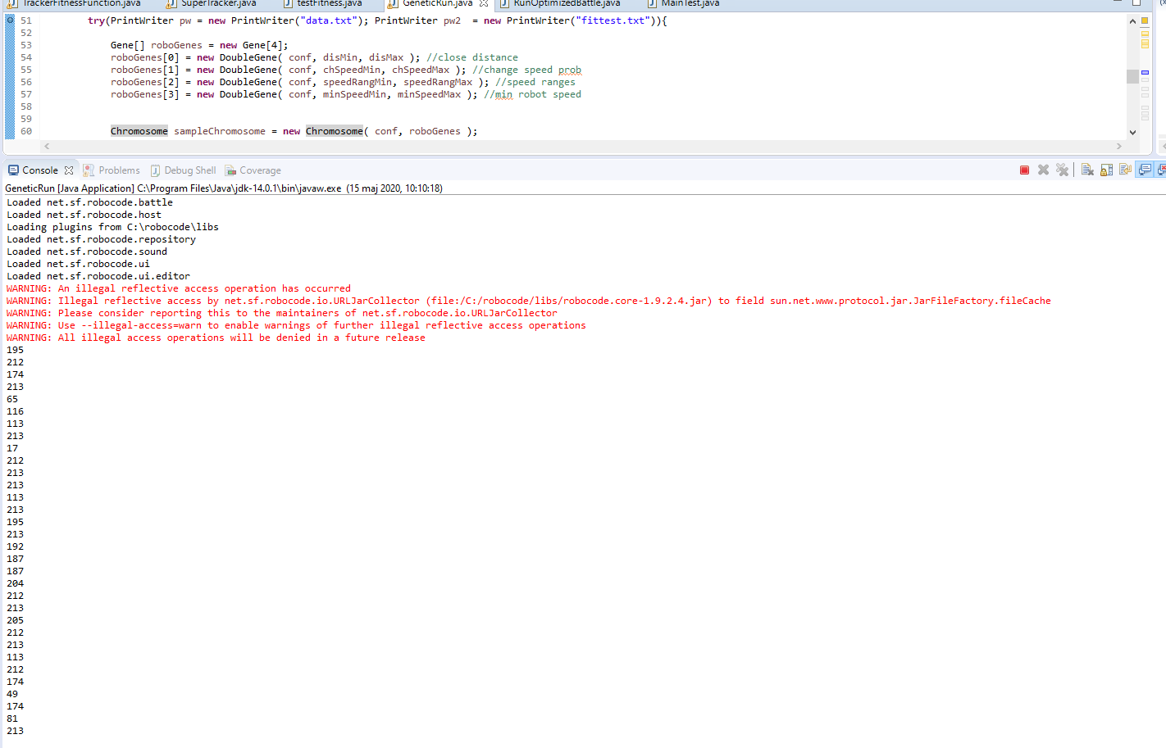
Screen shot of running application. We can see each evaluated fitness value printed to the console

Slide 11
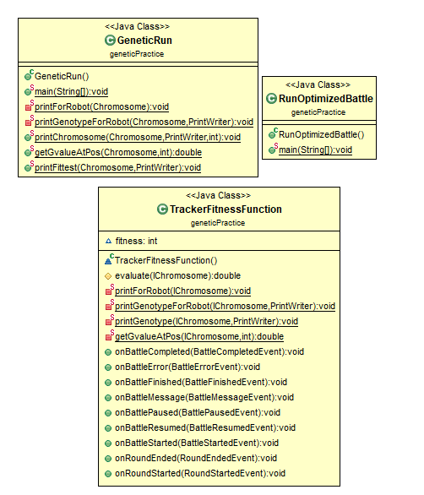
Class diagram for geneticPractice project

Slide 12
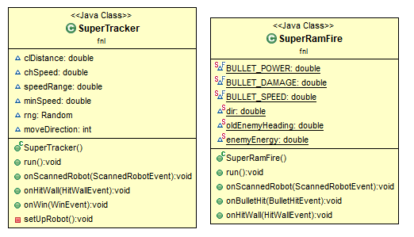
Class diagram for geneticRobots project

Slide 13
What have I learned during the exercise:
How the genetic algorithm works
How to set up enviroment for a genetic algorithm
What influences the result of GA and how succesful it is
Some basics of useing event driven programming
How to use ObjectAid UML diagram generator for Eclipse
How to keep my saninty while working with robocode

Slide 14
Videos:
Brief explanation of the solution:
https://youtu.be/pN_EyvzOcAs
(one thing to notice: after I recorded that video I added function that prints the best chromosome found to a roboFile.dat so RunOptimizedBattle.java actually runs for the best cgrormosome that was found)
Video showing how the fittest robot fights:
https://youtu.be/rNTpU3KWKvs

